Slide 1
Bullets and Numbering

Slide 2
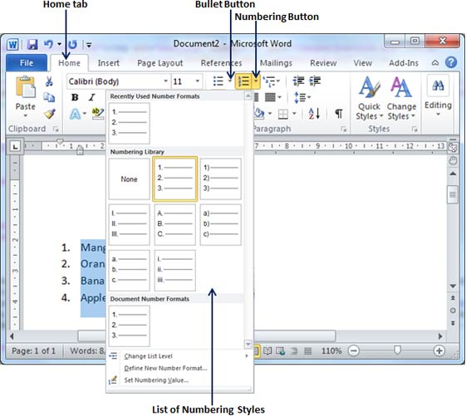
Using Bulleted Lists, Numbered Lists

Slide 3
Use the Home command tab or AutoFormatting
• This is an example of a bulleted list

Slide 4
• The BULLETS button in the Paragraph group acts like a toggle switch.
Clicking once turns it on; clicking a second time turns it off
• To change the bullet style or the indents, use the dialog box option
Using the Home Command Tab

Slide 5
How to create a bulleted list from existing text: Use the text below
First select the text to be bulleted
Then go the Home Tab
Select the Bullets Button in the Paragraph Group
Select the bullet style you desire
Computers
Part of your Life
p. 213 Act 1
p 221 Act 6

Slide 6
Select the text Then switch by inserting a symbol of your choice
Bullets can be customised for example with a symbol

Slide 7
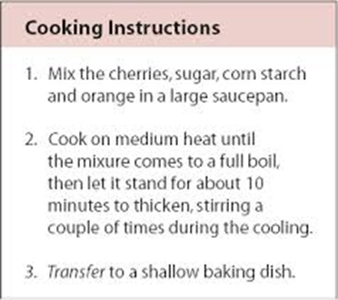
Numbering
You can quickly add numbers to text . number in the list.

Slide 8
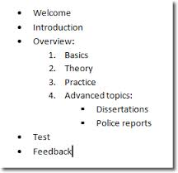
Type any text that you want. Press ENTER to add the next list item.
numbered list: Type * (asterisk) to start a bulleted list or 1. to start a numbered list, and then press SPACEBAR or the TAB key.

Slide 9

Activity
Learner’s worksheet in Data Files Folder

